Slide 2
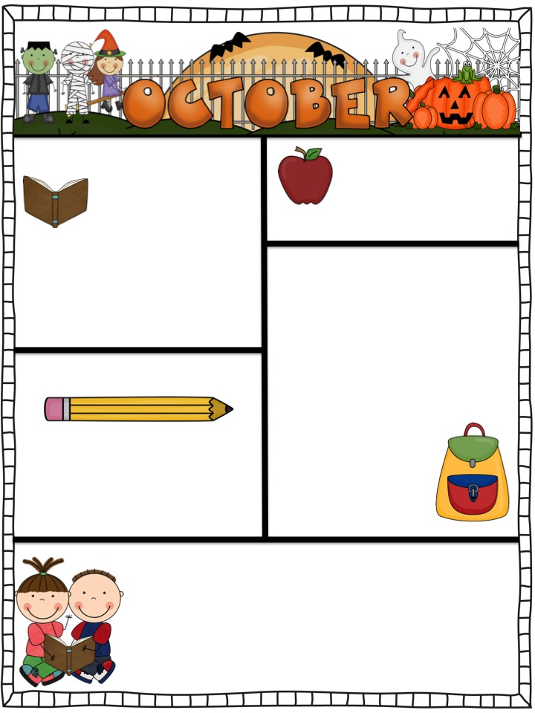
Teacher’s Corner
Contact Information
McDonnell Elementary School
4010 Binderton Place SW
Huntsville, AL 35805
(256) 428-7280
dunia.roberts@hsv-k12.org
Make sure you are checking the binder each night for important information.
Spelling lists will be sent home each week on Monday. Keep in mind that spelling lists are specific to each child’s needs. Not all lists will be the same for each child.
October is Fire Prevention Month, please talk with your child about fire safety.
Please read with your child each night. Reading is an essential 1st grade skill ☺.
This Month’s Skills
Reading: 1. Using pictures and illustrations to describe key details
2. Retelling stories
2. Recognize the features of a sentence (first word capitalized and ending punctuation)
Language: 1. Common, proper and possessive nouns
2. Capitalizing names of people and dates
3. Ending punctuation marks
Math: 1. Addition word problems
2. Addition and Subtraction within 10
3. Place Value
Social Studies: Needs/Wants,
Buy, sell, trade
Science: Seasons and Time Change
Important Dates
October 3-7: Fall Break
October 14: Pumpkin Painting
October 17: Report Cards Go Home
October 31: Book Character Day
Stay tuned for a date for our annual Fall Festival!
Busy Bee’s Reader Campaign
Beginning October 10, our class will participate in the Busy Bee’s Reader Campaign. It is our goal to get 100 AR points as a class before the end of the 9 week’s grading period. That means that as a class, we must read 200 books! While meeting this goal will be a challenge, I know that we can do it! Make sure you are doing your part by reading an AR book each night, and be prepared to take an AR test the next morning!

